Slide 1
Awakened Way
Buddha’ Teaching to Become Buddha:
Awakened in Nirvana in Dharma from Karma
f karma to dharma
from Karma to Dharma
Rosan Osamu Yoshida, Ph.D.
Presentation
At
Vesak Celebration
June 9, 2024 C.E.

Slide 2
Born-blinds Groping For An Animal
(Human Conditions)
King Ādassa (Mirror) asked the born-blinds to touch an animal and tell him their findings.
They groped, guessed, insisted and even
fought for their findings as below;
Snake, Hose, Pillar, Winnow, Wall, etc.

Slide 3
Two Truths/Worlds
Mundane Truth (Conventional Truth):
Karma/Samsara World
Creature/Deluded World
Separate, Selfish,
Sick Suffering World
Supra-mundaneTruth (Ultimate Truth):
Dharma/Nirvana World
Buddha/Awakened World
Holy, Harmonious,
Healthy, Happy World

Slide 4
Karma
= Ceremony: Action: Habit: Heredity
√ kṛ means “grow or create” with
the body, mouth, mind
The Buddha said,
“All beings are karma-births, -heirs,
-owners, -machines, -refuged.”

Slide 5
Karma Beings Shift States
Six States/Paths/Destinies
Celestial Beings
Human Beings
Animal Beings
Fighting Devils
Hungry Ghosts
Hell Beings

Slide 6
Karma Causes Suffering
Karma characterized by Self-survival strife
(thus,“Selfish Genes,” “Original Sin, etc.”)
3 Poisons: Desire, Divisiveness, Delusion
Delusion = no witness (nescience) of nirvana
= no witness of selfless truth
= no witness of Dependent
Co-origination, etc.

Slide 7
12-limb Dependent Co-origination
Old oral tradition (capable only in linear presentation):
Nescience → formation → consciousness → name-form → six bases → contact → feeling → craving → appropriation → becoming → birth → aging-death
2. New structural presentation = showing samsara (flowing/change) /suffering:
Terms:
Name-form = sense object = dharma/s
Six organs = six sense organs
Contact = contact of aense organs・sense objects・consciousnesses
Formations = action/function (past/present actions of body, mouth, mind)
Becoming = involvement into birth/death（change/samsara）
Craving = urge, lit. thirst
craving-formation・suffering is called
three steps (sando)
Nescience = no witness of nirvana
Appropriation = （body/mind）possession = (self) identification
Birth/aging-death = birth/aging/death(due to appropriation/IE）
.
Name-form
Six bases
Consciousness
Feeling
Formations
becoming
Birth/aging death
contact
craving
nescience
(body/mouth/mind action)
suffering
Appropriation
（identification）

Slide 8
12-limbed Dependent Origination
(Becoming Wheel)
Old oral tradition (embryo-genetial interpretation spanning past, present, future):
Nescience – formations – consciousness – name-form – six bases – contact – feeling –
craving – appropriation – becoming - birth – aging-death
2. New structural interpretation = showing suffering of samsara (impermanence):
name-form
Notes on the terms:
Name-form = sense object
= dharma
Six bases = six sense organs
Contact = contact of sense organ,
sense object and consciousness
Formation = function (karma)
Becoming = birth/aging/death
= samsara (flow) Craving, formations & suffering
are called “three steps (sando)
Nescience (existential ignorance)
appropriates body-mind as self,
involved in becoming (birth,
aging, death = samsara).
contact
six bases
consciousness
feeling
formations
appropriation
becoming
birth/aging-death
craving
nescience
suffering

Slide 9
Zen (Meditation) = Stilling Karma
Zen (Za-zen: sitting meditation) stills Karma,
sees Dharma, serves and saves all, reaching
Nirvana.
Nirvana = No-wind (of Karma)
“Nivāte padīpa”
(lamp-light in no-wind)

Slide 10
1st stage of zen (jhāna)
reflection
contemplation
joy
comfort
one-pointedness
5 coverings (lust-desire, covetousness-malevolence,
sloth-drowsiness, agitation-worry, doubt) extinct
4 fluxes (lust, becoming, view, nescience) still extant

Slide 11
2nd stage of zen (jhāna)
joy
comfort
one-pointedness of mind
4 fluxes (lust,
becoming,
view,
nescience)
now extinct

Slide 12
3rd stage of zen (jhāna)
comfort
one-pointedness of mind
equipoised

Slide 13
4th stage of zen (jhāna)
one-pointedness of mind
equanimity

Slide 14
Nirvana/Awakening
nirvāṇa = nivāta: no wind：no karma wind
║
karma（Triple actions：body/emotion/volition）stilled
↑
Zazen ＝ still karma (body/mouth/mind)
4th Zen → nirvana (no self, no fear, etc.)
awakening (Law of all pheno-
mena: 12 limb Dependent
Co-origination, etc.)
“nivāte padīpa”: (“light in no-wind”)
present → past, future
↓

Slide 15
Karma to Nirvana
1. Nirvana & Dependent Cessation:
a. Cessation of craving ⇨ suffering
b. Cessation of nescience ⇨ samsara
c. Cessation of mental fabrication
(: pure perception: “seen only, etc.”)
2. Nirvana w/ remainder and w/o remainder:
a. Nirvana w/ remainder (5 aggregates)
b. Nirvana w/o remainder (5 aggregates
= form, idea, feeling, formations, consciousness)
)

Slide 16
Nirvana Definition
Definition: No-wind (nir-vāna: ni-vāta), of karma
(= not blown up & down by karma)
Characteristics:
Essence: Universal (beyond influence of karma)
Nature: Pure (before influence karma)
Function: Free (unbound by karma)
Practicality: Here now (for all beyond karma)

Slide 17
Dharma
A. Meanings of Dharma (√dhṝ, holding form/norm)
1. Dharma = form = phenomena/truth
2. Dharma = norm = law/ethic
3. Dharma = teaching (of the Buddha)
B. Dharma of all dharmas
(Law of all phenomena)
= Dependent Origination
(All phenomena are Dependently Originated
on causes and conditions.)

Slide 18
Truth like Tree
Tree etymology :
√dhṝ (endure) = the root of Dharma (hold) also
Tree nature ( = the meaning of dharma also) :
- Lasting long (ten thousand year old trees)
- Harmony with all (air, water, light, gravity,
animals, etc.)
- Universal w/o discrimination, destruction
Koan: “The cypress tree in the Garden.”

Slide 19
Freedom
= Beloved domain or familiar relationship
( = Sanskrit Priya-dhāman)
1. Freedom from karma (action, habit, heredity
of body/mouth/mind)
2. Freedom of karma (action, habit, heredity
of body/mouth/mind)

Slide 20
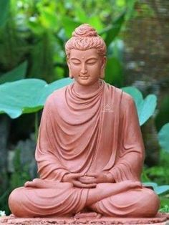
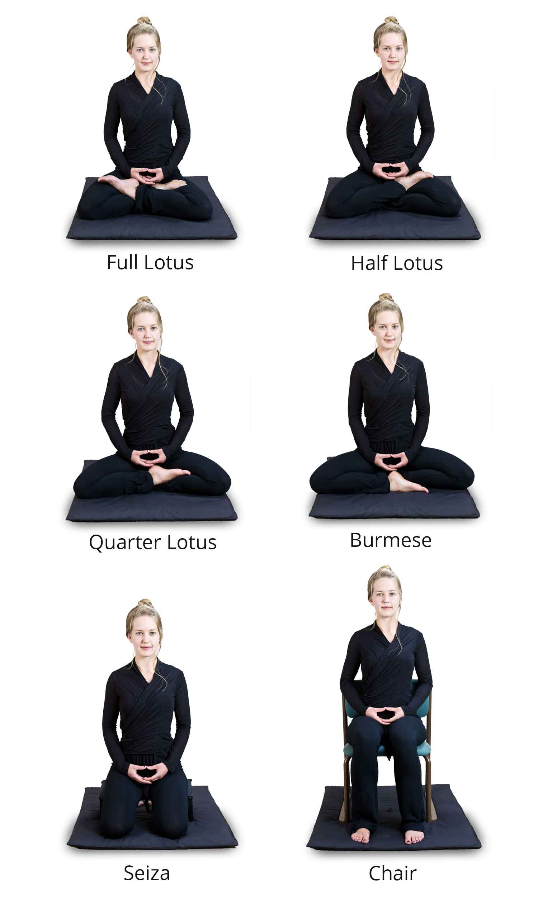
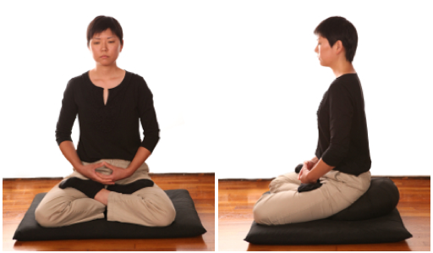
Zazen Postures
Full Lotus

Slide 21
All Should/Can Attain
Nirvana/Awakened
Anyone can sit still (zazen), settle in nirvana, see the Dharma, serve and save all.
Anyone can be freed from karma and become awakened (buddha) in nirvana
Anyone can live in fair, friendly, free, and full.
Anyone can become holy, harmonious, healthy, and happy.
Anyone can harmonize the mind/body/world.

Slide 22
Two Refuges
Self Refuge:
Take refuge in yourself, not others.
Dharma Refuge:
Take refuge in the Dharma, not others.
- Buddha’s last admonishments.

Slide 23
Nirvana Fruit
Free function (from karma: triple poisons, sins,
discriminations, defilements, delusions, death,
conventions: conventional truth (view/values),
unmoved, indestructible, no coverings, etc.
Full function (awakening/activation of the
ultimate truth: wholly wholesome way/world;
prognosis/peace in original nature, limitless life,
light, liberation, love, appreciation, use of all, etc.

Slide 24
Religion
Etymology: From Latin religare (re-union)
Definition: the Holy (by Rudolf Otto)
Religion = reunion with holiness from sin
Holiness = wholly wholesomeness
= the wholesome world/way
Sin = separation (selfishness, sickness)
cf. a-sunder, sundry,

Slide 25
Four Dharmas
Four Holy Truths: Suffering, Cause,
Cessation, Way to cessation
Four Zen Stages: 1st , 2nd , 3rd , 4th Stages
Four Limitlessnesses: Friendship, Compassion,
(Brahma-abode) Joy, Equanimity
Four Embracing Matters: Giving, Loving Words,
Beneficial Actions, Sameness
Four Potency Bases: Desire, Striving, Concent-
ration, Investigation
,

Slide 26
Friend Is Ideal Figure of Religions
A Friend (Mitra, Mithra, Metteyya, Maitreya, Miroku, Milu, Mazda, Messiah, et al) is an ideal fugure in universal religions (A future savior means everyone’s potential).
“A friend in need is a friend indeed.”
Homo sapience = Homo sociale
= Homo symbolicum, etc.

Slide 27
Five Dharmas
Five Precepts: No Killing, No Stealing, No Lying,
No Sexual Misconduct, No
Intoxicant
Five Aggregates: Forms, Feelings, Ideas,
Formations, Consciousness
Five Powers/Faculties: Faith, Striving, Concent-
ration, Prognosis
Five Ways/Destinies: Hell Beings, Hungry Ghosts,
Animals, Humans, Celestials
1.
non-
violence
&
respect
for
life
1.
non-
violence
&
respect
for
life

Slide 28
Declaration toward a Global Ethic
Parliament of World’s Religions, Chicago, 1993
5 Irrevocable Directives:
Commitment to the culture of
4.
equal rights
&
partnership
between
men and
women
5.
sustain-
ability
&
care for the earth
1.
non-
violence
&
respect
for
life
2.
solidarity
&
just
economic
order
3.
tolerance
&
a life
of
truthfulness

Slide 29
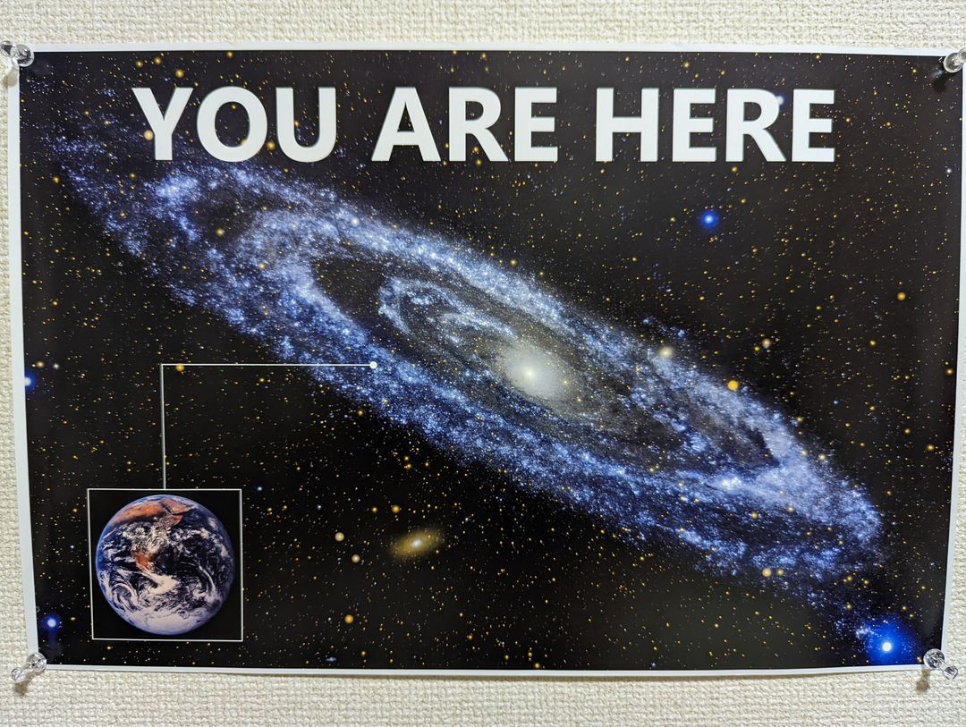
Declaration toward a Global Ethic
Parliament of World’s Religions, Chicago, 1993
4 Irrevocable Directives:
Commitment to the culture of
4.
equal rights
&
partnership
between
men and
women
5.
sustain-
ability
&
care for the earth
1.
non-
violence
&
respect
for
life
2.
solidarity
&
just
economic
order
3.
tolerance
&
a life
of
truthfulness
a clear crystal ball
in the Solar System, halfway from the center of the Milky
Way galaxy.
.”

Slide 30

Rare Is Human Life
The Buddha said,
“To be born as a human being is rare, like a blind turtle living at the bottom of the ocean coming up to the surface of it once in a hundred years and accidently sticking its head into a hole of a floating log.
Rarer and more precious is it for a human being to encounter the Awakened Way!”

Slide 31
A Clear
Crystal Ball
“The entire world in ten directions is a clear crystal ball”
Xuansha

